Slide 1
CSE 103 Discrete Structures
Introduction to Graphs
These class notes are based on material from our textbook, Discrete Mathematics and Its Applications, 6th ed., by Kenneth H. Rosen, published by McGraw Hill, Boston, MA, 2006. They are intended for classroom use only and are not a substitute for reading the textbook.

Slide 2
Simple Graph
A simple graph consists of
a nonempty set of vertices called V
a set of edges (unordered pairs of distinct elements of V) called E
Notation: G = (V,E)

Slide 3
Simple Graph Example
Detroit
New York
San Francisco
Chicago
Denver
Washington
Los Angeles
This simple graph represents a network.
The network is made up of computers and telephone links between computers

Slide 4
Multigraph
A multigraph can have multiple edges (two or more edges connecting the same pair of vertices).
Detroit
New York
San Francisco
Chicago
Denver
Washington
Los Angeles
There can be multiple telephone lines between two computers in the network.

Slide 5
Pseudograph
A Pseudograph can have multiple edges and loops (an edge connecting a vertex to itself).
Detroit
San Francisco
Chicago
New York
Denver
Washington
Los Angeles
There can be telephone lines in the network from a computer to itself.

Slide 6
Types of Undirected Graphs
Pseudographs
Multigraphs
Simple Graphs

Slide 7
Directed Graph
The edges are ordered pairs of (not necessarily distinct) vertices.
Detroit
Chicago
New York
San Francisco
Denver
Washington
Los Angeles
Some telephone lines in the network may operate in only one direction. Those that operate in two directions are represented by pairs of edges in opposite directions.

Slide 8
Directed Multigraph
A directed multigraph is a directed graph with multiple edges between the same two distinct vertices.
Detroit
New York
Chicago
San Francisco
Denver
Washington
Los Angeles
There may be several one-way lines in the same direction from one computer to another in the network.

Slide 9
Types of Directed Graphs
Directed
Multigraphs
Directed Graphs

Slide 10
Graph Models
Graphs can be used to model structures, sequences, and other relationships.
Example: ecological niche overlay graph
Species are represented by vertices
If two species compete for food, they are connected by a vertex

Slide 11
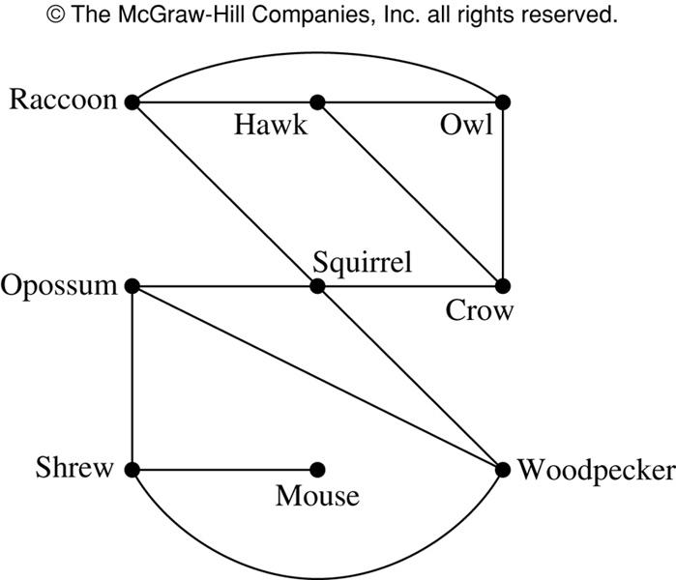
Niche Overlay Graph

Slide 12
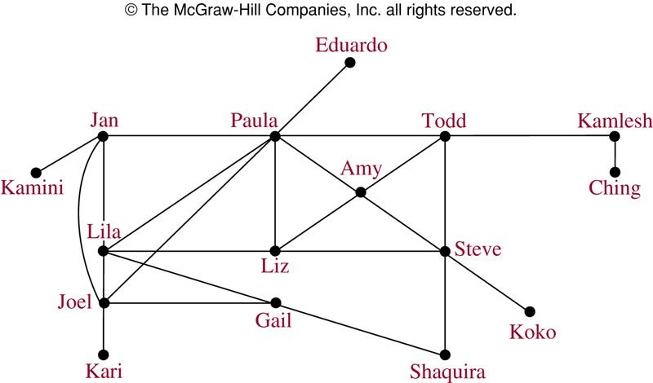
Acquaintanceship Graph

Slide 13
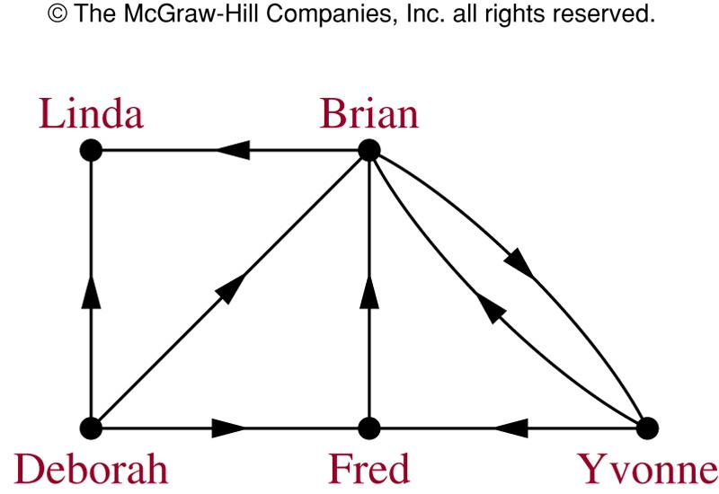
Influence Graph

Slide 14
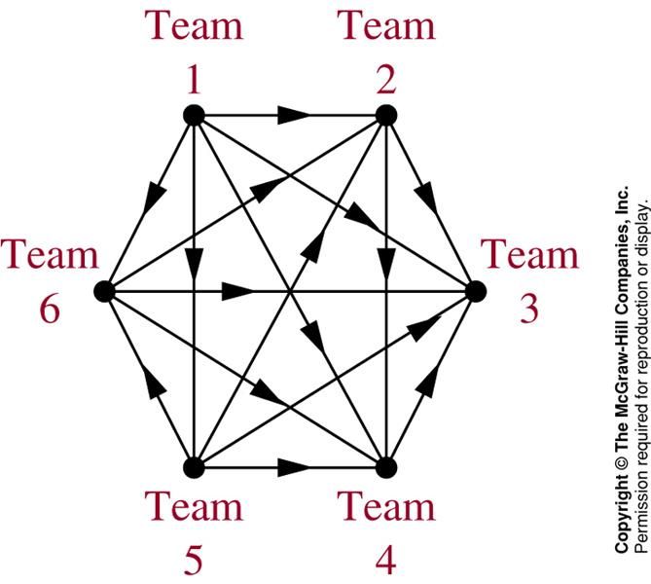
Round-Robin Tournament Graph

Slide 15
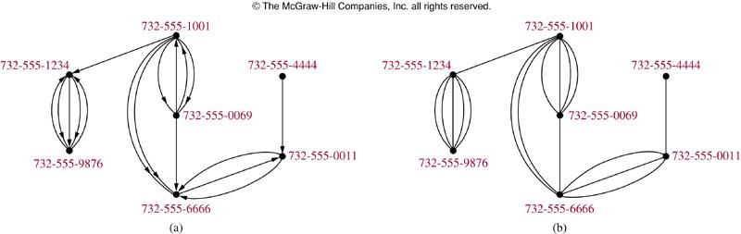
Call Graphs
Directed graph (a) represents calls from a telephone number to another.
Undirected graph (b) represents called between two numbers.

Slide 16
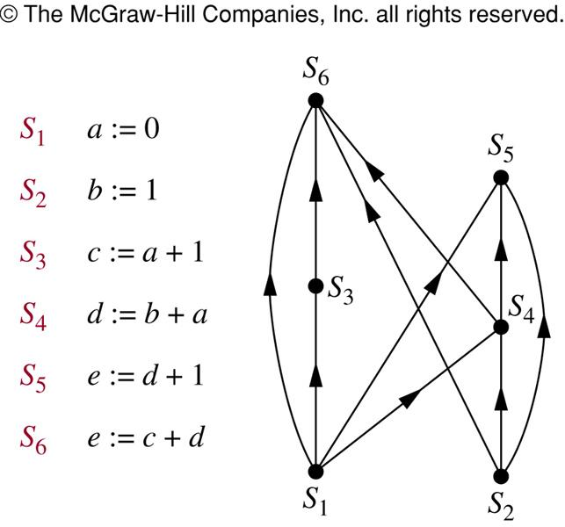
Precedence Graphs
In concurrent processing, some statements must be executed before other statements. A precedence graph represents these relationships.

Slide 17
Hollywood Graph
In the Hollywood graph:
Vertices represent actors
Edges represent the fact that the two actors have worked together on some movie
As of October 2007, this graph had 893,283 vertices, and over 20 million edges.

Slide 18
Shortest-path Algorithms
A decade or so ago a game called "Six Degrees of Kevin Bacon" was popular on college campuses.
The idea, based on the idea that “it’s a small world”, was to try to find the fewest number of connections to link any other actor with Kevin Bacon.
It was discovered that you could connect Kevin Bacon with just about any other actor in 6 links or so.

Slide 19
Bacon Numbers
In the Hollywood Graph, the Bacon Number of an actor x is defined as the length of the shortest path connecting x and the actor Kevin Bacon.
The average Kevin Bacon number is 2.957
For more information, see the Oracle of Bacon website at the University of Virginia Computer Science Department.

Slide 20
Bacon Numbers
Kevin Bacon Number | Number of People
0 | 1 (Kevin Bacon himself)
1 | 2030
2 | 190213
3 | 557245
4 | 133450
5 | 9232
6 | 958
7 | 137
8 | 17

Slide 21
Shortest-path Algorithms
Writing an efficient program for finding the shortest path in a graph is an important optimizing task in Computer Science.
For futher information about shortest-path algorithms, take CSE 4833, or read the course textbook, Introduction to Algorithms by Cormen, Leiserson, Rivest, and Stein.

Slide 22
Summary
Type | Edges | Loops | Multiple Edges
Simple Graph | Undirected | NO | NO
Multigraph | Undirected | NO | YES
Pseudograph | Undirected | YES | YES
Directed Graph | Directed | YES | NO

Slide 23
CSE 103 Discrete Structures
Graph Terminology
These class notes are based on material from our textbook, Discrete Mathematics and Its Applications, 6th ed., by Kenneth H. Rosen, published by McGraw Hill, Boston, MA, 2006. They are intended for classroom use only and are not a substitute for reading the textbook.

Slide 24
Adjacent Vertices in Undirected Graphs
Two vertices, u and v in an undirected graph G are called adjacent (or neighbors) in G, if {u,v} is an edge of G.
An edge e connecting u and v is called incident with vertices u and v, or is said to connect u and v.
The vertices u and v are called endpoints of edge {u,v}.

Slide 25
Degree of a Vertex
The degree of a vertex in an undirected graph is the number of edges incident with it
except that a loop at a vertex contributes twice to the degree of that vertex
The degree of a vertex v is denoted by deg(v).

Slide 26
Example
c
d
b
a
g
f
e
Find the degrees of all the vertices:
deg(a) = 2, deg(b) = 6, deg(c) = 4, deg(d) = 1,
deg(e) = 0, deg(f) = 3, deg(g) = 4

Slide 27
Adjacent Vertices in Directed Graphs
When (u,v) is an edge of a directed graph G, u is said to be adjacent to v and v is said to be adjacent from u.
(u, v)
initial vertex terminal vertex

Slide 28
Degree of a Vertex
In-degree of a vertex v
The number of vertices adjacent to v (the number of edges with v as their terminal vertex
Denoted by deg⁻(v)
Out-degree of a vertex v
The number of vertices adjacent from v (the number of edges with v as their initial vertex)
Denoted by deg⁺(v)
A loop at a vertex contributes 1 to both the in-degree and out-degree.

Slide 29
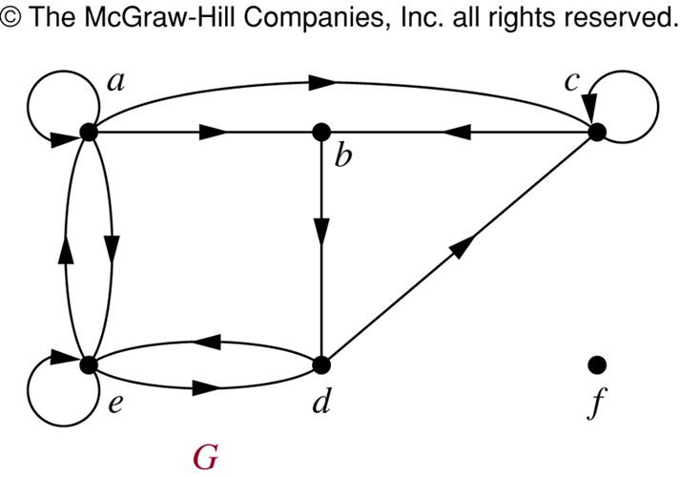
Example

Slide 30
Example
a c
b
e d f
Find the in-degrees and out-degrees of this digraph.
In-degrees: deg⁻(a) = 2, deg⁻(b) = 2, deg⁻(c) = 3, deg⁻(d) = 2, deg⁻(e) = 3, deg⁻(f) = 0
Out-degrees: deg⁺(a) = 4, deg⁺(b) = 1, deg⁺(c) = 2, deg⁺(d) = 2, deg⁺(e) = 3, deg⁺(f) = 0

Slide 31
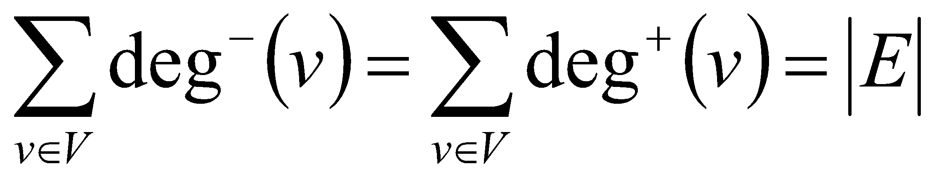
Theorem 3
The sum of the in-degrees of all vertices in a digraph = the sum of the out-degrees = the number of edges.
Let G = (V, E) be a graph with directed edges. Then:

Slide 32
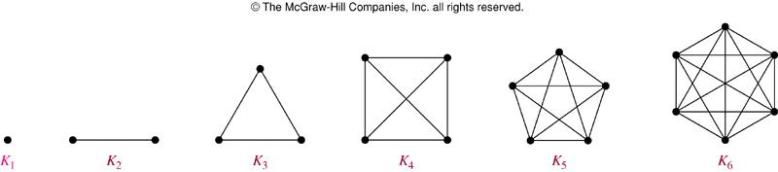
Complete Graph
The complete graph on n vertices (K_{n}) is the simple graph that contains exactly one edge between each pair of distinct vertices.
The figures above represent the complete graphs, K_{n}, for n = 1, 2, 3, 4, 5, and 6.

Slide 33
Cycle
The cycle C_{n} (n ≥ 3), consists of n vertices v₁, v₂, …, v_{n} and edges {v₁,v₂}, {v₂,v₃}, …, {v_{n-1},v_{n}}, and {v_{n},v₁}.
Cycles:
C₃
C₄
C₅
C₆

Slide 34
Wheel
When a new vertex is added to a cycle C_{n} and this new vertex is connected to each of the n vertices in C_{n}, we obtain a wheel W_{n}.
Wheels:
W₃
W₄
W₅
W₆

Slide 35
Bipartite Graph
A simple graph is called bipartite if its vertex set V can be partitioned into two disjoint nonempty sets V₁ and V₂ such that every edge in the graph connects a vertex in V₁ and a vertex in V₂ (so that no edge in G connects either two vertices in V₁ or two vertices in V₂).
a b
c d
e
a
d
e
b
c

Slide 36
Bipartite Graph (Example)
1 2
6 3
5 4
Is C₆ Bipartite?
Yes. Why?
Because:
its vertex set can be partitioned into the two sets V₁ = {v₁, v₃, v₅} and V₂ = {v₂, v₄, v₆}
every edge of C₆ connects a vertex in V₁ with a vertex in V₂

Slide 37
Bipartite Graph (Example)
1
2 3
Is K₃ Bipartite?
No. Why not?
Because:
Each vertex in K₃ is connected to every other vertex by an edge
If we divide the vertex set of K₃ into two disjoint sets, one set must contain two vertices
These two vertices are connected by an edge
But this can’t be the case if the graph is bipartite

Slide 38
Subgraph
A subgraph of a graph G = (V,E) is a graph H = (W,F) where W ⊆ V and F ⊆ E.
K₅
C₅
Is C₅ a subgraph of K₅?

Slide 39
Union
The union of 2 simple graphs G₁ = (V₁, E₁) and G₂ = (V₂, E₂) is the simple graph with vertex set V = V₁∪V₂ and edge set E = E₁∪E₂. The union is denoted by G₁∪G₂.
c
c
c
b
d
f
f
b
d
b
d
a
e
e
a
e
a
S₅
C₅
W₅
S₅ ∪ C₅ = W₅

Slide 40
CSE 103 Discrete Structures
Representing Graphs and Graph Isomorphism
These class notes are based on material from our textbook, Discrete Mathematics and Its Applications, 6th ed., by Kenneth H. Rosen, published by McGraw Hill, Boston, MA, 2006. They are intended for classroom use only and are not a substitute for reading the textbook.

Slide 41
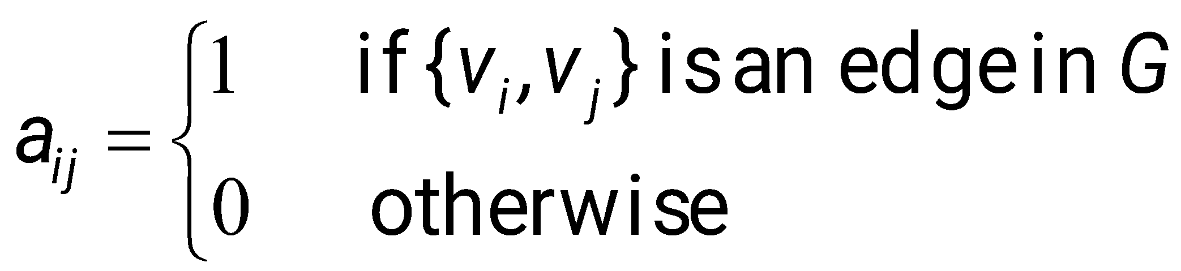
Adjacency Matrix
A simple graph G = (V,E) with n vertices can be represented by its adjacency matrix, A, where the entry a_{ij} in row i and column j is:

Slide 42
Adjacency Matrix Example
c
To
a b c d e f
From
b
d
f
a
b
c
d
e
f
0 1 0 0 1 1
1 0 1 0 0 1
0 1 0 1 0 1
0 0 1 0 1 1
1 0 0 1 0 1
1 1 1 1 1 0
a
e
W₅
{v₁,v₂}
row column

Slide 43
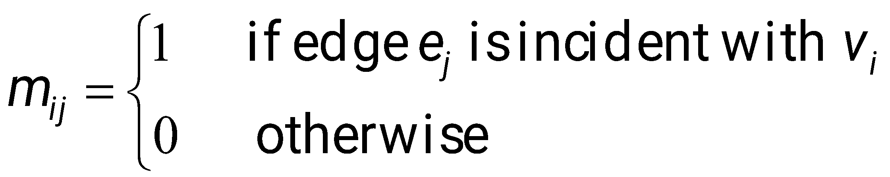
Incidence Matrix
Let G = (V,E) be an undirected graph. Suppose v₁,v₂,v₃,…,v_{n} are the vertices and e₁,e₂,e₃,…,e_{m} are the edges of G. The incidence matrix w.r.t. this ordering of V and E is the n×m matrix M = [m_{ij}], where

Slide 44
Incidence Matrix Example
Represent the graph shown with an incidence matrix.
e₁ e₂ e₃ e₄ e₅ e₆
edges
v₁ v₂ v₃
e₆
v₁
v₂
v₃
v₄
v₅
1 1 0 0 0 0
0 0 1 1 0 1
0 0 0 0 1 1
1 0 1 0 0 0
0 1 0 1 1 0
e₃
e₁
e₄
e₅
e₂
v₄ v₅
vertices

Slide 45
Isomorphism
Two simple graphs are isomorphic if:
there is a one-to one correspondence between the vertices of the two graphs
the adjacency relationship is preserved

Slide 46
Isomorphism (Cont.)
The simple graphs G₁=(V₁,E₁) and G₂=(V₂,E₂) are isomorphic if there is a one-to-one and onto function f from V₁ to V₂ with the property that a and b are adjacent in G₁ iff f(a) and f(b) are adjacent in G₂, for all a and b in V₁.

Slide 47
Example
u₁
u₂
v₁
v₂
u₃
u₄
v₃
v₄
G
H
Are G and H isomorphic?
f(u₁) = v₁, f(u₂) = v₄, f(u₃) = v₃, f(u₄) = v₂

Slide 48
Invariants
Invariants – properties that two simple graphs must have in common to be isomorphic
Same number of vertices
Same number of edges
Degrees of corresponding vertices are the same
If one is bipartite, the other must be; if one is complete, the other must be; and others …

Slide 49
Example
b
b
a
c
a
c
e
d
e
d
G
H
Are G and H isomorphic?

Slide 50
Example
Are these two graphs isomorphic?
u₁ u₂
u₅ u₃
u₄
v₁ v₂
v₅
v₃
v₄
G H
They both have 5 vertices
They both have 8 edges
They have the same number of vertices with the same degrees: 2, 3, 3, 4, 4.

Slide 51
Example (Cont.)
G H H → G?
u₁ u₂ u₃ u₄ u₅
u₁ 0 1 0 1 1
u₂ 1 0 1 1 1
u₃ 0 1 0 1 0
u₄ 1 1 1 0 1
u₅ 1 1 0 1 0
v₁ v₂ v₃ v₄ v₅
v₁ 0 0 1 1 1
v₂ 0 0 1 0 1
v₃ 1 1 0 1 1
v₄ 1 0 1 0 1
v₅ 1 1 1 1 0
v₁ v₃ v₂ v₅ v₄
v₁
v₃
v₂
v₅
v₄
G and H don’t appear to be isomorphic.
However, we haven’t tried mapping vertices from G onto H yet.

Slide 52
Example (Cont.)
Start with the vertices of degree 2 since each graph only has one:
deg(u₃) = deg(v₂) = 2 therefore f(u₃) = v₂

Slide 53
Example (Cont.)
Now consider vertices of degree 3
deg(u₁) = deg(u₅) = deg(v₁) = deg(v₄) = 3
therefore we must have either one of
f(u₁) = v₁ and f(u₅) = v₄
f(u₁) = v₄ and f(u₅) = v₁

Slide 54
Example (Cont.)
Now try vertices of degree 4:
deg(u₂) = deg(u₄) = deg(v₃) = deg(v₅) = 4
therefore we must have one of:
f(u₂) = v₃ and f(u₄) = v₅ or
f(u₂) = v₅ and f(u₄) = v₃

Slide 55
Example (Cont.)
There are four possibilities (this can get messy!)
f(u₁) = v₁, f(u₂) = v₃, f(u₃) = v₂, f(u₄) = v₅, f(u₅) = v₄
f(u₁) = v₄, f(u₂) = v₃, f(u₃) = v₂, f(u₄) = v₅, f(u₅) = v₁
f(u₁) = v₁, f(u₂) = v₅, f(u₃) = v₂, f(u₄) = v₃, f(u₅) = v₄
f(u₁) = v₄, f(u₂) = v₅, f(u₃) = v₂, f(u₄) = v₃, f(u₅) = v₁

Slide 56
Example (Cont.)
G H H’
u₁ u₂ u₃ u₄ u₅
u₁ 0 1 0 1 1
u₂ 1 0 1 1 1
u₃ 0 1 0 1 0
u₄ 1 1 1 0 1
u₅ 1 1 0 1 0
v₁ v₂ v₃ v₄ v₅
v₁ 0 0 1 1 1
v₂ 0 0 1 0 1
v₃ 1 1 0 1 1
v₄ 1 0 1 0 1
v₅ 1 1 1 1 0
v₁ v₃ v₂ v₅ v₄
v₁ 0 1 0 1 1
v₃ 1 0 1 1 1
v₂ 0 1 0 1 0
v₅ 1 1 1 0 1
v₄ 1 1 0 1 0
We permute the adjacency matrix of H (per function choices above) to see if we get the adjacency of G. Let’s try:
f(u₁) = v₁, f(u₂) = v₃, f(u₃) = v₂, f(u₄) = v₅, f(u₅) = v₄
Does G = H’? Yes!

Slide 57
Example (Cont.)
G H H’
u₁ u₂ u₃ u₄ u₅
u₁ 0 1 0 1 1
u₂ 1 0 1 1 1
u₃ 0 1 0 1 0
u₄ 1 1 1 0 1
u₅ 1 1 0 1 0
v₁ v₂ v₃ v₄ v₅
v₁ 0 0 1 1 1
v₂ 0 0 1 0 1
v₃ 1 1 0 1 1
v₄ 1 0 1 0 1
v₅ 1 1 1 1 0
v₄ v₃ v₂ v₅ v₁
v₄ 0 1 0 1 1
v₃ 1 0 1 1 1
v₂ 0 1 0 1 0
v₅ 1 1 1 0 1
v₁ 1 1 0 1 0
It turns out that
f(u₁) = v₄, f(u₂) = v₃, f(u₃) = v₂, f(u₄) = v₅, f(u₅) = v₁
also works.

Slide 58
CSE 103 Discrete Structures
Connectivity
These class notes are based on material from our textbook, Discrete Mathematics and Its Applications, 6th ed., by Kenneth H. Rosen, published by McGraw Hill, Boston, MA, 2006. They are intended for classroom use only and are not a substitute for reading the textbook.

Slide 59
Paths in Undirected Graphs
There is a path from vertex v₀ to vertex v_{n} if there is a sequence of edges from v₀ to v_{n}
This path is labeled as v₀,v₁,v₂,…,v_{n} and has a length of n.
The path is a circuit if the path begins and ends with the same vertex.
A path is simple if it does not contain the same edge more than once.

Slide 60
Paths in Undirected Graphs
A path or circuit is said to pass through the vertices v₀, v₁, v₂, …, v_{n} or traverse the edges e₁, e₂, …, e_{n}.

Slide 61
Example
u₁, u₄, u₂, u₃
Is it simple?
yes
What is the length?
3
Does it have any circuits?
no
u₁ u₂
u₅ u₄ u₃

Slide 62
Example
u₁, u₅, u₄, u₁, u₂, u₃
Is it simple?
yes
What is the length?
5
Does it have any circuits?
Yes; u₁, u₅, u₄, u₁
u₁ u₂
u₅ u₃
u₄

Slide 63
Example
u₁, u₂, u₅, u₄, u₃
Is it simple?
yes
What is the length?
4
Does it have any circuits?
no
u₁ u₂
u₅ u₃
u₄

Slide 64
Connectedness
An undirected graph is called connected if there is a path between every pair of distinct vertices of the graph.
There is a simple path between every pair of distinct vertices of a connected undirected graph.

Slide 65
Example
Are the following graphs connected?
a
b
a
b
c
e
f
d
c
d
f
g
e
Yes No

Slide 66
Connectedness (Cont.)
A graph that is not connected is the union of two or more disjoint connected subgraphs (called the connected components of the graph).

Slide 67
Example
What are the connected components of the following graph?
b
d
e
f
a
c
h
g

Slide 68
Example
What are the connected components of the following graph?
b
d
e
f
a
c
h
g
{a, b, c}, {d, e}, {f, g, h}

Slide 69
Cut edges and vertices
If one can remove a vertex (and all incident edges) and produce a graph with more connected components, the vertex is called a cut vertex.
If removal of an edge creates more connected components the edge is called a cut edge or bridge.

Slide 70
Example
Find the cut vertices and cut edges in the following graph.
a
d
f
g
b
c
e
h

Slide 71
Example
Find the cut vertices and cut edges in the following graph.
a
d
f
g
b
c
e
h
Cut vertices: c and e
Cut edge: (c, e)

Slide 72
Connectedness in Directed Graphs
A directed graph is strongly connected if there is a directed path between every pair of vertices.
A directed graph is weakly connected if there is a path between every pair of vertices in the underlying undirected graph.

Slide 73
Example
Is the following graph strongly connected? Is it weakly connected?
This graph is strongly connected. Why? Because there is a directed path between every pair of vertices.
If a directed graph is strongly connected, then it must also be weakly connected.
a b
c
e d

Slide 74
Example
Is the following graph strongly connected? Is it weakly connected?
This graph is not strongly connected. Why not? Because there is no directed path between a and b, a and e, etc.
However, it is weakly connected. (Imagine this graph as an undirected graph.)
a b
c
e d

Slide 75
Connectedness in Directed Graphs
The subgraphs of a directed graph G that are strongly connected but not contained in larger strongly connected subgraphs (the maximal strongly connected subgraphs) are called the strongly connected components or strong components of G.

Slide 76
Example
What are the strongly connected components of the following graph?
This graph has three strongly connected components:
The vertex a
The vertex e
The graph consisting of
V = {b, c, d} and
E = { (b, c), (c, d), (d, b)}
a b
c
e d

Slide 77
CSE 103 Discrete Structures
Euler and Hamilton Paths
These class notes are based on material from our textbook, Discrete Mathematics and Its Applications, 6th ed., by Kenneth H. Rosen, published by McGraw Hill, Boston, MA, 2006. They are intended for classroom use only and are not a substitute for reading the textbook.

Slide 78
Euler Paths and Circuits
The Seven bridges of Königsberg
C
c
D
A
a
d
B
b

Slide 79
Euler Paths and Circuits
An Euler path is a path using every edge of the graph G exactly once.
An Euler circuit is an Euler path that returns to its start.
C
Does this graph have an Euler circuit?
No.
A
D
B

Slide 80
Necessary and Sufficient Conditions
How about multigraphs?
A connected multigraph has a Euler circuit iff each of its vertices has an even degree.
A connected multigraph has a Euler path but not an Euler circuit iff it has exactly two vertices of odd degree.

Slide 81
Example
Which of the following graphs has an Euler circuit?
a
b
a
b
a
b
e
e
d
c
d
c
c
d
e
yes no no
(a, e, c, d, e, b, a)

Slide 82
Example
Which of the following graphs has an Euler path?
a
b
a
b
a
b
e
e
d
c
d
c
c
d
e
yes no yes
(a, e, c, d, e, b, a ) (a, c, d, e, b, d, a, b)

Slide 83
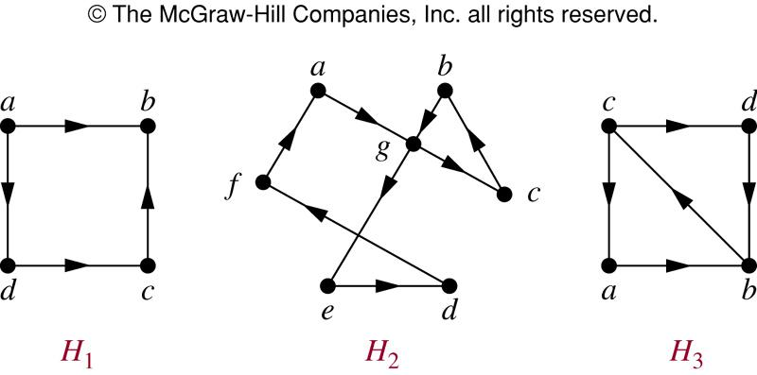
Euler Circuit in Directed Graphs
NO (a, g, c, b, g, e, d, f, a) NO

Slide 84
Euler Path in Directed Graphs
NO (a, g, c, b, g, e, d, f, a) (c, a, b, c, d, b)

Slide 85
Hamilton Paths and Circuits
A Hamilton path in a graph G is a path which visits every vertex in G exactly once.
A Hamilton circuit is a Hamilton path that returns to its start.

Slide 86
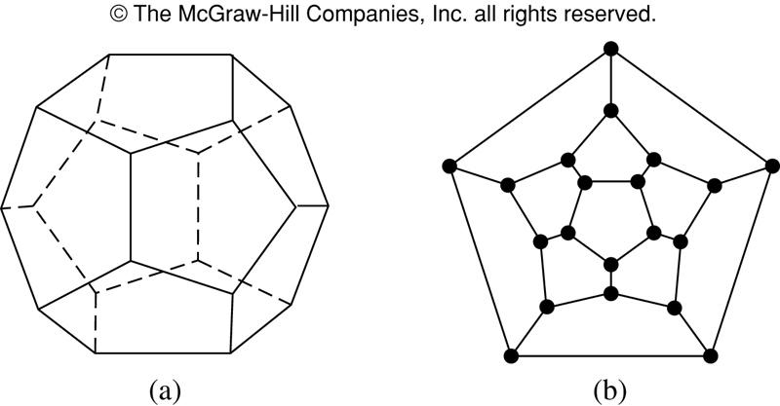
Hamilton Circuits
Is there a circuit in this graph that passes through each vertex exactly once?

Slide 87
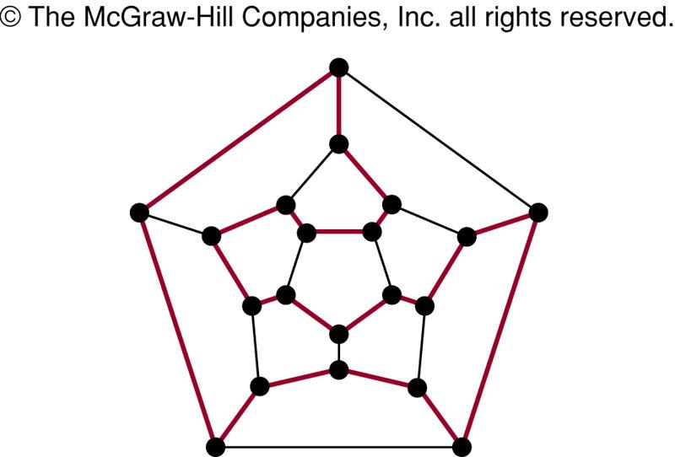
Hamilton Circuits
Yes; this is a circuit that passes through each vertex exactly once.

Slide 88
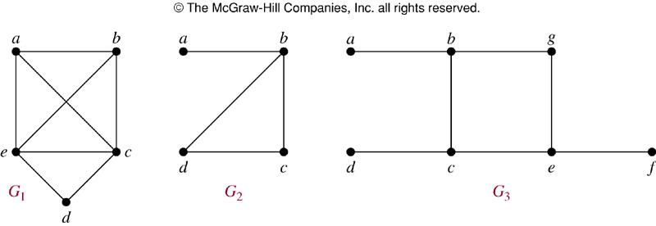
Finding Hamilton Circuits
Which of these three figures has a Hamilton circuit? Of, if no Hamilton circuit, a Hamilton path?

Slide 89
Finding Hamilton Circuits
G₁ has a Hamilton circuit: a, b, c, d, e, a
G₂ does not have a Hamilton circuit, but does have a Hamilton path: a, b, c, d
G₃ has neither.

Slide 90
Finding Hamilton Circuits
Unlike the Euler circuit problem, finding Hamilton circuits is hard.
There is no simple set of necessary and sufficient conditions, and no simple algorithm.

Slide 91
Properties to look for ...
No vertex of degree 1
If a node has degree 2, then both edges incident to it must be in any Hamilton circuit.
No smaller circuits contained in any Hamilton circuit (the start/endpoint of any smaller circuit would have to be visited twice).

Slide 92
A Sufficient Condition
Let G be a connected simple graph with n vertices with n ≥ 3.
G has a Hamilton circuit if the degree of each vertex is ≥ n/2.

Slide 93
Travelling Salesman Problem
A Hamilton circuit or path may be used to solve practical problems that require visiting “vertices”, such as:
road intersections
pipeline crossings
communication network nodes
A classic example is the Travelling Salesman Problem – finding a Hamilton circuit in a complete graph such that the total weight of its edges is minimal.

Slide 94
Summary
Property | Euler | Hamilton
Repeated visits to a given node allowed? | Yes | No
Repeated traversals of a given edge allowed? | No | No
Omitted nodes allowed? | No | No
Omitted edges allowed? | No | Yes

Slide 95
CSE 103 Discrete Structures
Planar Graphs
These class notes are based on material from our textbook, Discrete Mathematics and Its Applications, 6th ed., by Kenneth H. Rosen, published by McGraw Hill, Boston, MA, 2006. They are intended for classroom use only and are not a substitute for reading the textbook.

Slide 96
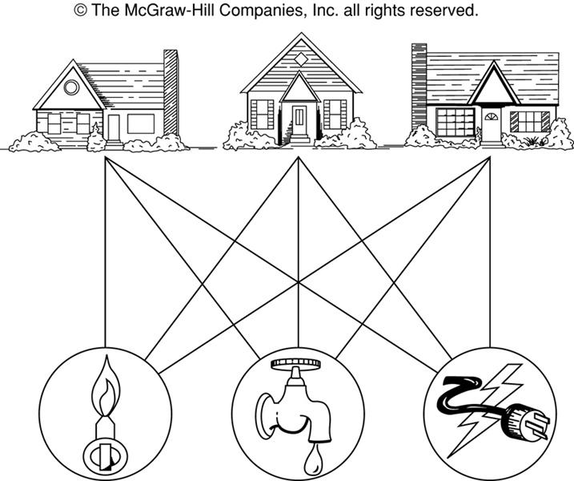
The House-and-Utilities Problem

Slide 97
Planar Graphs
Consider the previous slide. Is it possible to join the three houses to the three utilities in such a way that none of the connections cross?

Slide 98
Planar Graphs
Phrased another way, this question is equivalent to: Given the complete bipartite graph K_{3,3}, can K_{3,3} be drawn in the plane so that no two of its edges cross?
K_{3,3}

Slide 99
Planar Graphs
A graph is called planar if it can be drawn in the plane without any edges crossing.
A crossing of edges is the intersection of the lines or arcs representing them at a point other than their common endpoint.
Such a drawing is called a planar representation of the graph.

Slide 100
Example
A graph may be planar even if it is usually drawn with crossings, since it may be possible to draw it in another way without crossings.

Slide 101
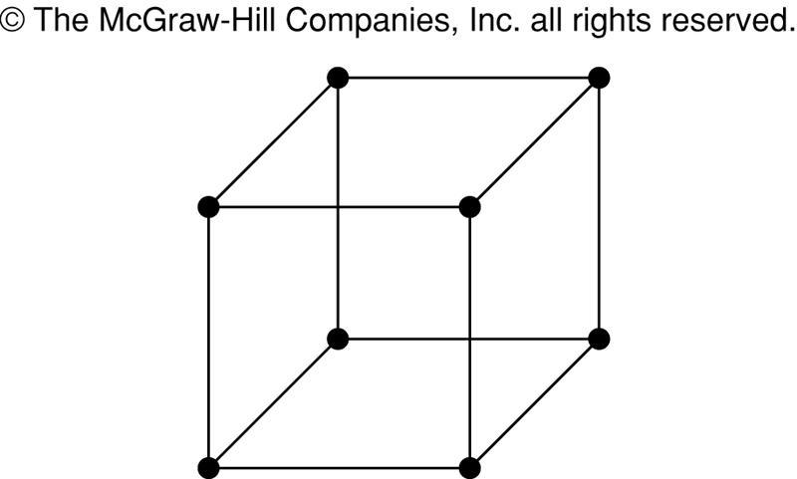
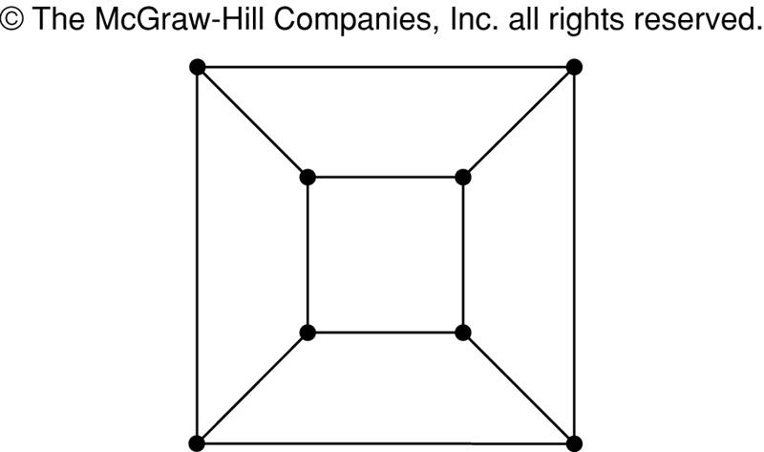
Example
A graph may be planar even if it represents a 3-dimensional object.

Slide 102
Planar Graphs
We can prove that a particular graph is planar by showing how it can be drawn without any crossings.
However, not all graphs are planar.
It may be difficult to show that a graph is nonplanar. We would have to show that there is no way to draw the graph without any edges crossing.

Slide 103
Regions
Euler showed that all planar representations of a graph split the plane into the same number of regions, including an unbounded region.
R₄ R₃ R₂
R₁

Slide 104
Regions
In any planar representation of K_{3,3}, vertex v₁ must be connected to both v₄ and v₅, and v₂ also must be connected to both v₄ and v₅.
v₁ v₂ v₃
v₄ v₅ v₆

Slide 105
Regions
The four edges {v₁, v₄}, {v₄, v₂}, {v₂, v₅}, {v₅, v₁} form a closed curve that splits the plane into two regions, R₁ and R₂.
v₁ v₅
R₂ R₁
v₄ v₂

Slide 106
Regions
Next, we note that v₃ must be in either R₁ or R₂.
Assume v₃ is in R₂. Then the edges {v₃, v₄} and {v₄, v₅} separate R₂ into two subregions, R₂₁ and R₂₂.
v₁ v₅ v₁ v₅
R₂₁
R₂ R₁ → v₃
R₂₂
v₄ v₂ v₄ v₂

Slide 107
Regions
Now there is no way to place vertex v₆ without forcing a crossing:
If v₆ is in R₁ then {v₆, v₃} must cross an edge
If v₆ is in R₂₁ then {v₆, v₂} must cross an edge
If v₆ is in R₂₂ then {v₆, v₁} must cross an edge
v₁ v₅
R₂₁
v₃ R₁
R₂₂
v₄ v₂

Slide 108
Regions
Alternatively, assume v₃ is in R₁. Then the edges {v₃, v₄} and {v₄, v₅} separate R₁ into two subregions, R₁₁ and R₁₂.
v₁ v₅
R₁₁
R₂ R₁₂ v₃
v₄ v₂

Slide 109
Regions
Now there is no way to place vertex v₆ without forcing a crossing:
If v₆ is in R₂ then {v₆, v₃} must cross an edge
If v₆ is in R₁₁ then {v₆, v₂} must cross an edge
If v₆ is in R₁₂ then {v₆, v₁} must cross an edge
v₁ v₅
R₁₁
R₂ R₁₂ v₃
v₄ v₂

Slide 110
Planar Graphs
Consequently, the graph K_{3,3} must be nonplanar.
K_{3,3}

Slide 111
Regions
Euler devised a formula for expressing the relationship between the number of vertices, edges, and regions of a planar graph.
These may help us determine if a graph can be planar or not.

Slide 112
Euler’s Formula
Let G be a connected planar simple graph with e edges and v vertices. Let r be the number of regions in a planar representation of G. Then r = e - v + 2.
R₄ R₃ R₂
R₁
# of edges, e = 6
# of vertices, v = 4
# of regions, r = e - v + 2 = 4

Slide 113
Euler’s Formula (Cont.)
Corollary 1: If G is a connected planar simple graph with e edges and v vertices where v ≥ 3, then e ≤ 3v - 6.
Is K₅ planar?
K₅

Slide 114
Euler’s Formula (Cont.)
K₅ has 5 vertices and 10 edges.
We see that v ≥ 3.
So, if K₅ is planar, it must be true that e ≤ 3v – 6.
3v – 6 = 3*5 – 6 = 15 – 6 = 9.
So e must be ≤ 9.
But e = 10.
So, K₅ is nonplanar.
K₅

Slide 115
Euler’s Formula (Cont.)
Corollary 2: If G is a connected planar simple graph, then G has a vertex of degree not exceeding 5.

Slide 116
Euler’s Formula (Cont.)
Corollary 3: If a connected planar simple graph has e edges and v vertices with v ≥ 3 and no circuits of length 3, then e ≤ 2v - 4.
Is K_{3,3} planar?

Slide 117
Euler’s Formula (Cont.)
K_{3,3} has 6 vertices and 9 edges.
Obviously, v ≥ 3 and there are no circuits of length 3.
If K_{3,3} were planar, then e ≤ 2v – 4 would have to be true.
2v – 4 = 2*6 – 4 = 8
So e must be ≤ 8.
But e = 9.
So K_{3,3} is nonplanar.
K_{3,3}

Slide 118
CSE 103 Discrete Structures
Graph Coloring
These class notes are based on material from our textbook, Discrete Mathematics and Its Applications, 6th ed., by Kenneth H. Rosen, published by McGraw Hill, Boston, MA, 2006. They are intended for classroom use only and are not a substitute for reading the textbook.

Slide 119
Introduction
When a map is colored, two regions with a common border are customarily assigned different colors.
We want to use the smallest number of colors instead of just assigning every region its own color.

Slide 120
4-Color Map Theorem
It can be shown that any two-dimensional map can be painted using four colors in such a way that adjacent regions (meaning those which sharing a common boundary segment, and not just a point) are different colors.

Slide 121
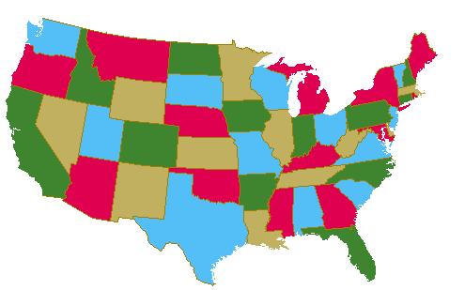
Map Coloring
Four colors are sufficient to color a map of the contiguous United States.
Source of map: http://www.math.gatech.edu/~thomas/FC/fourcolor.html

Slide 122
Dual Graph
Each map in a plane can be represented by a graph.
Each region is represented by a vertex.
Edges connect to vertices if the regions represented by these vertices have a common border.
Two regions that touch at only one point are not considered adjacent.
The resulting graph is called the dual graph of the map.

Slide 123
Dual Graph Examples
B
B
G
A
C
D
A
F
C
D
E
E
b
a d f g
e
b
a e
d
c
c

Slide 124
Graph Coloring
A coloring of a simple graph is the assignment of a color to each vertex of the graph so that no two adjacent vertices are assigned the same color.
The chromatic number of a graph is the least number of colors needed for a coloring of the graph.
The Four Color Theorem: The chromatic number of a planar graph is no greater than four.

Slide 125
Example
What is the chromatic number of the graph shown below?
The chromatic number must be at least 3 since a, b, and c must be assigned different colors. So Let’s try 3 colors first. 3 colors work, so the chromatic number of this graph is 3.
b e
a d g
c f

Slide 126
Example
What is the chromatic number for each of the following graphs?
White
White
Yellow
Green
Yellow
Yellow
White
White
Yellow
Yellow
White
Chromatic number: 2 Chromatic number: 3

Slide 127
Conclusion
In this chapter we have covered:
Introduction to Graphs
Graph Terminology
Representing Graphs and Graph Isomorphism
Graph Connectivity
Euler and Hamilton Paths
Planar Graphs
Graph Coloring

